Slide 1
Programming Obesity:
A Code Health Epidemic
Aaron W. Hsu arcfide@sacrideo.us, Functional Conf 2019, Bengaluru, India

Slide 2
Imagine/Dream

Slide 3
Direct
Fast
Transmissive

Slide 4
Empower vs. Control

Slide 5
More domain knowledge,
Less systems rumination

Slide 6
The Main Thing

Slide 7
Obsolete? Hardly.

Slide 8
Essential
vs.
Accidental

Slide 9
We Are
Consumer and Producer

Slide 10
We are in this together

Slide 11
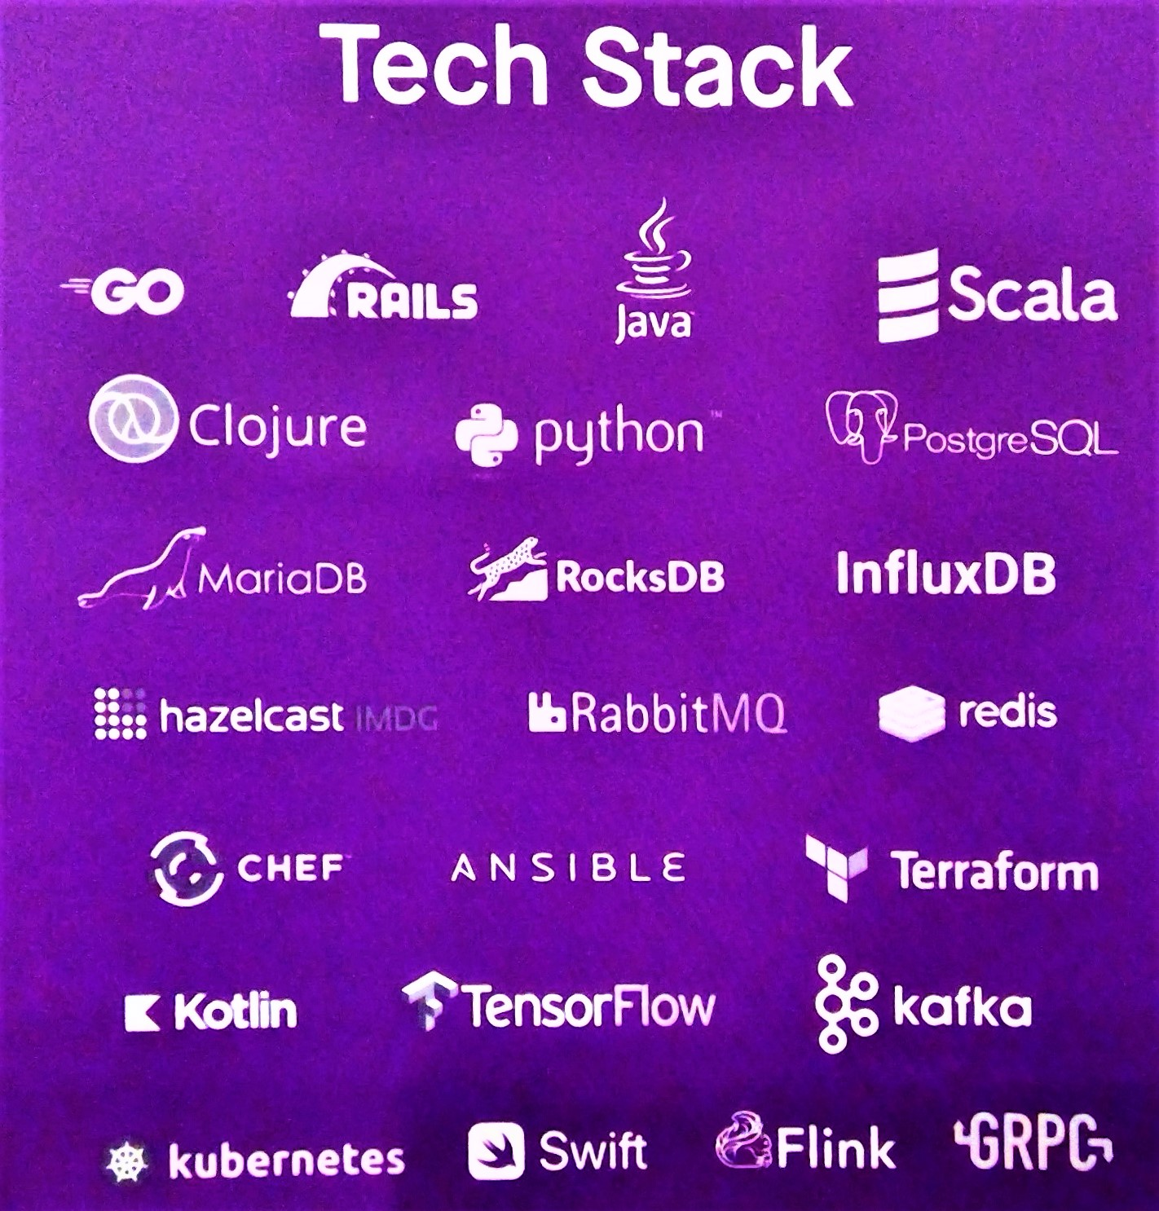

Slide 12
Programming Obesity

Slide 13
Cascading Systemic Failure to Simplify and Tendency Towards Unsustainable Waste

Slide 14
Structural Complexity
Performance
Economy

Slide 15
Change

Slide 16
Change is Uncomfortable

Slide 17
Break Points

Slide 18
Simple:
Faster:
Economical:

Slide 19
Impact

Slide 20
Don’t wait

Slide 21
Given Up

Slide 22
Where do we start?

Slide 23
Generalized pointers are the Refined Sugar of Programming

Slide 24
∘
┌──┬──┴────┐
∘ ∘ ∘
│ ┌┴┐ ┌───┼───┐
∘ ∘ ∘ ∘ ∘ ∘
│ ┌┴┐ ┌┴┐
∘ ∘ ∘ ∘ ∘

Slide 25
(Expr (e)
v
(B.0 ([name ns]) e)
(A.0 ([name ns]) num* ...)
(A.3 ([name ns]) v* ...)
(E.1 ([name ns]) f e)
(E.2 ([name ns]) e f ebrk)
(E.4 ([name ns]) v ebrk e))

Slide 26
┌─┬────┬─┐
│t│n...│∘│
└─┴────┴┼┘
│┌──┬─┐ ┌───┐ ┌──┬─┐
└┤c1│∘┼─┤...┼─┤cn│⍬│
└──┴─┘ └───┘ └──┴─┘

Slide 27
┌─┬────┬─┐┌─┬─┐┌─┬─┐┌─┬─┐
│t│n...│∘┼┤∘│∘┼┤∘│∘┼┤∘│⍬│
└─┴────┴─┘└┼┴─┘└┼┴─┘└┼┴─┘
┌──────────┘ │ └───────────────┐
│┌─┬────┬─┐┌─┬─┐│┌─┬────┬─┐┌─┬─┐┌─┬─┐│┌─┬────┬─┐┌─┬─┐┌─┬─┐┌─┬─┐
└┤t│n...│∘┼┤∘│⍬│└┤t│n...│∘┼┤∘│∘┼┤∘│⍬│└┤t│n...│∘┼┤∘│∘┼┤∘│∘┼┤∘│⍬│
└─┴────┴─┘└┼┴─┘ └─┴────┴─┘└┼┴─┘└┼┴─┘ └─┴────┴─┘└┼┴─┘└┼┴─┘└┼┴─┘
┌───────────┘ ┌─────────┘ │ │ │ │
│ ┌──────┘ ┌─────┘ │ │┌───┘
│┌─┬────┬─┐│┌─┬────┬─┐┌─┬─┐│┌─┬────┬─┐ │ ││┌─┬────┬─┐
└┤t│n...│⍬│└┤t│n...│∘┼┤∘│⍬│└┤t│n...│⍬│ │ │└┤t│n...│⍬│
└─┴────┴─┘ └─┴────┴─┘└┼┴─┘ └─┴────┴─┘ │ │ └─┴────┴─┘
┌──────────────────────┘ ┌─────────────────────┘ │
│ ┌───────────────┘ ┌─────────────────────┘
│┌─┬────┬─┐│┌─┬────┬─┐┌─┬─┐┌─┬─┐│┌─┬────┬─┐┌─┬─┐┌─┬─┐
└┤t│n...│⍬│└┤t│n...│∘┼┤∘│∘┼┤∘│⍬│└┤t│n...│∘┼┤∘│∘┼┤∘│⍬│
└─┴────┴─┘ └─┴────┴─┘└┼┴─┘└┼┴─┘ └─┴────┴─┘└┼┴─┘└┼┴─┘
┌──────────────────────┘ │ ┌───────────┘ │
│ ┌────────────────┘ │ ┌─────┘
│┌─┬────┬─┐│┌─┬────┬─┐ │┌─┬────┬─┐│┌─┬────┬─┐
└┤t│n...│⍬│└┤t│n...│⍬│ └┤t│n...│⍬│└┤t│n...│⍬│
└─┴────┴─┘ └─┴────┴─┘ └─┴────┴─┘ └─┴────┴─┘

Slide 28
Eliminate
expedient complexity and waste

Slide 29
Achieve
real simplicity

Slide 30
Holistic Economy

Slide 31
Can a compiler be:
GPU hosted, fast, portable, and simple?

Slide 32
Impossible

Slide 33
Eliminate Everything

Slide 34
A New (Old) Hope

Slide 35
APL

Slide 36
0 0
┌──┬──┴──────┐
1 3 7 1
│ ┌┴┐ ┌─────┼────┐
2 4 6 8 11 14 2
│ ┌┴─┐ ┌┴─┐
5 9 10 12 13 3
⍉(⍳≢d),⍪d
0 1 2 3 4 5 6 7 8 9 10 11 12 13 14
0 1 2 1 2 3 2 1 2 3 3 2 3 3 2

Slide 37
Simple: 94% 15×
Faster: CPU 89% 9×
GPU 98% 56×
Economy: Raw 70% 3×
Ratio 88% 8×

Slide 38
 | LoC | Tokens | Names | Nodes
Nanopass | 1012 | 20947 | 248 | 14680
Co-dfns | 17 | 760 | 74 | 948

Slide 39
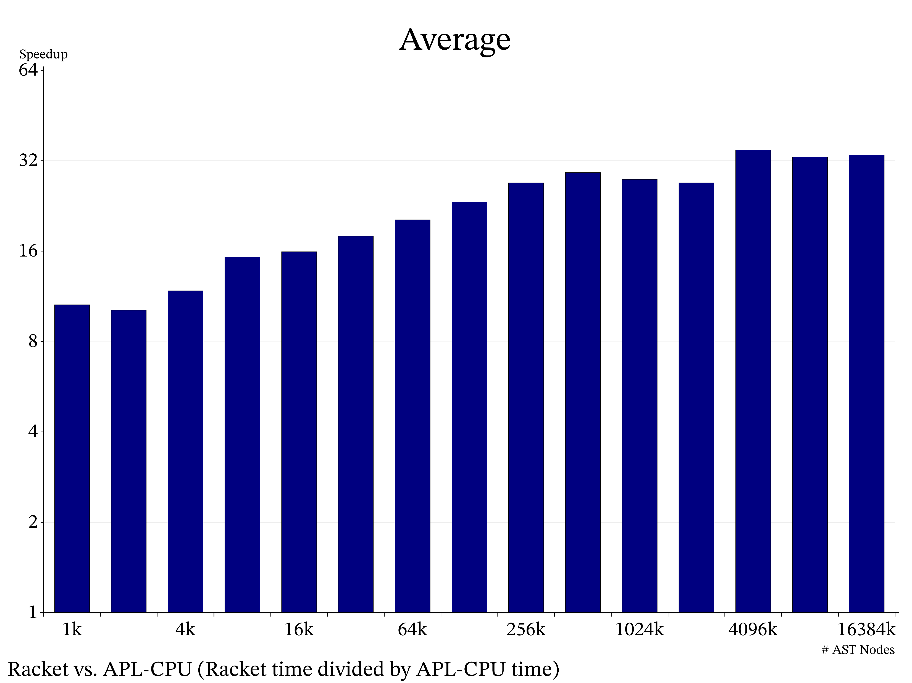
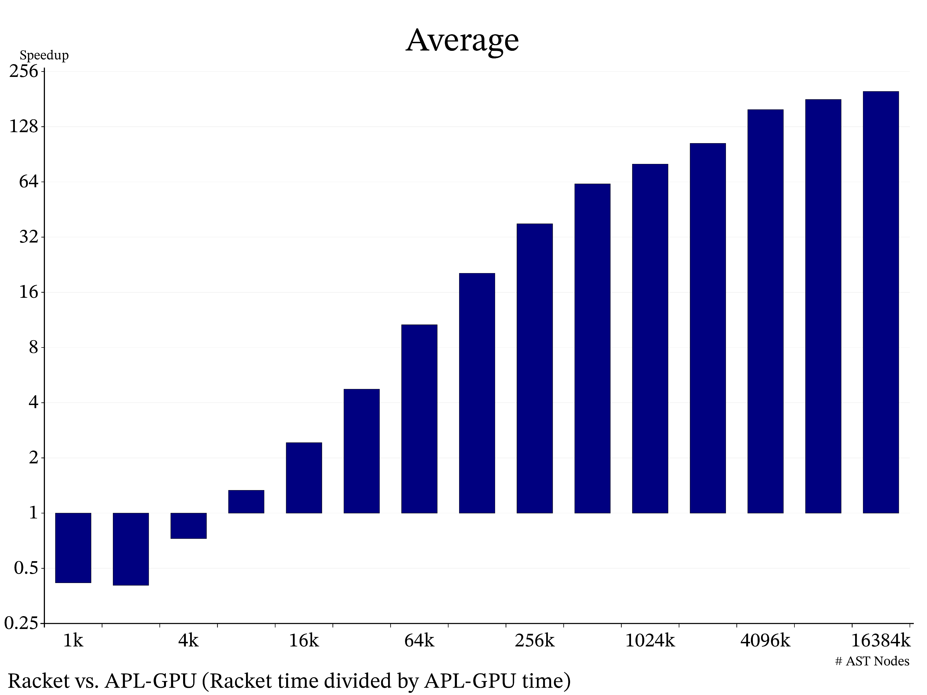
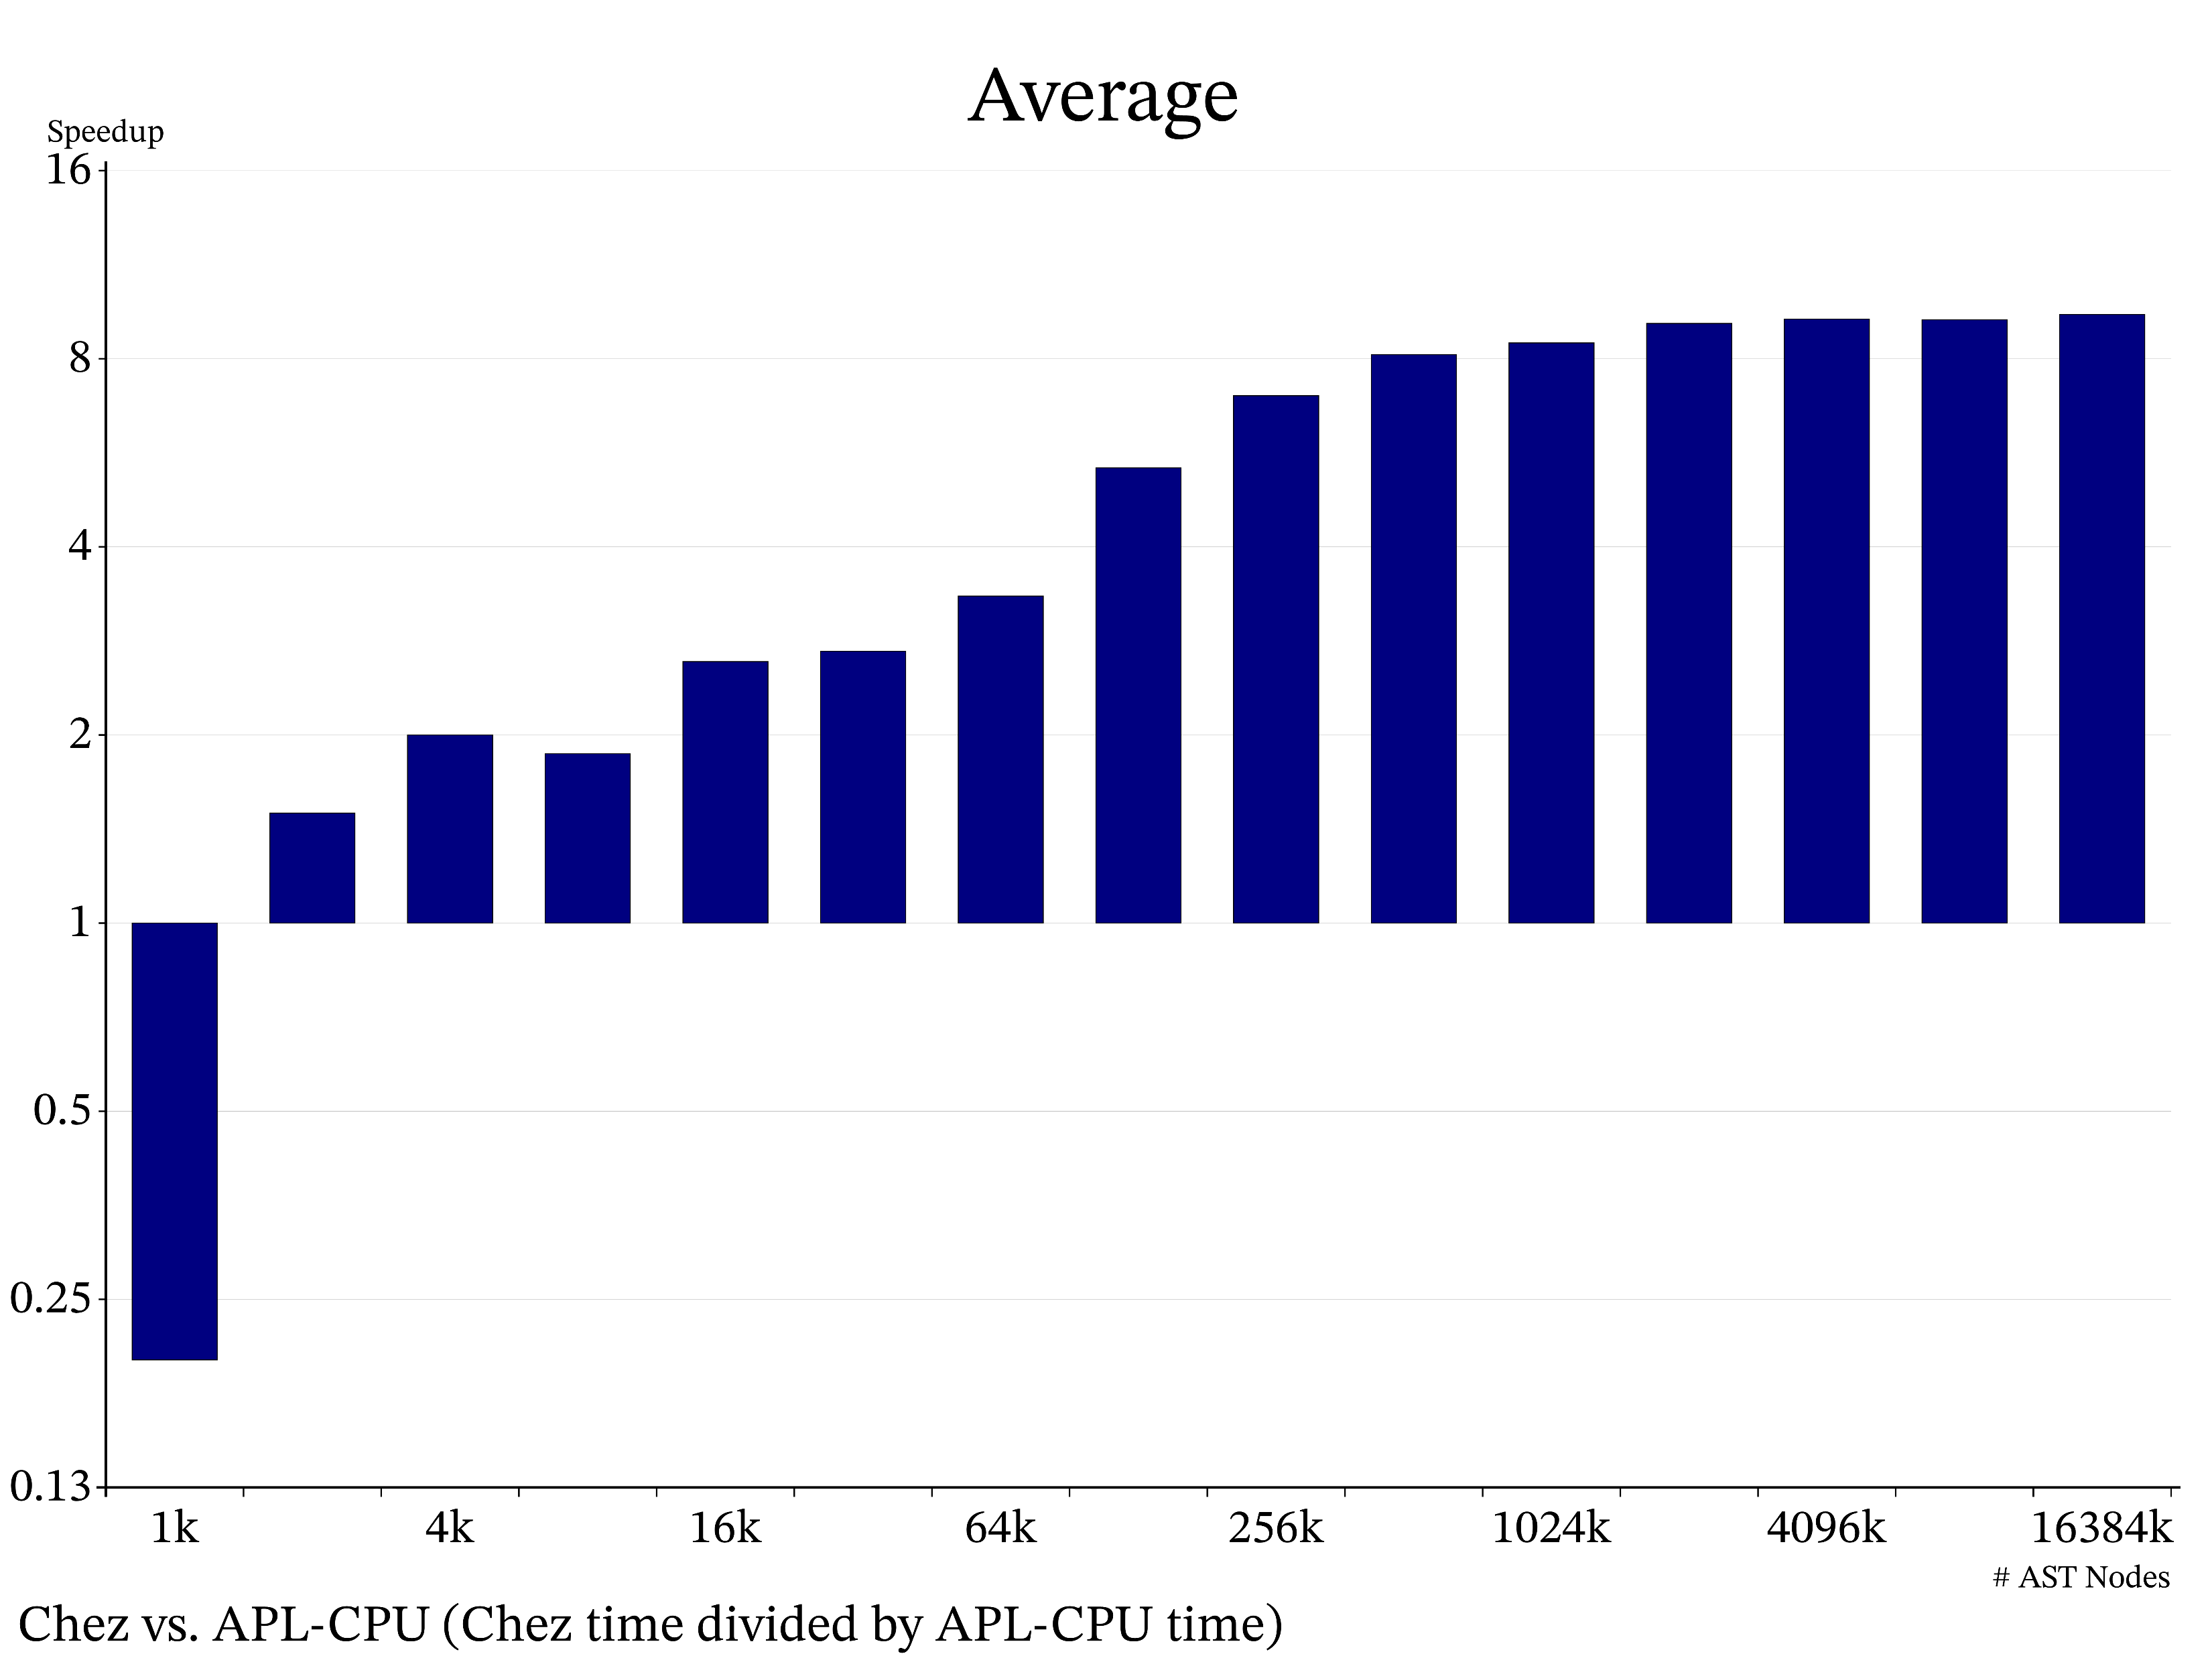
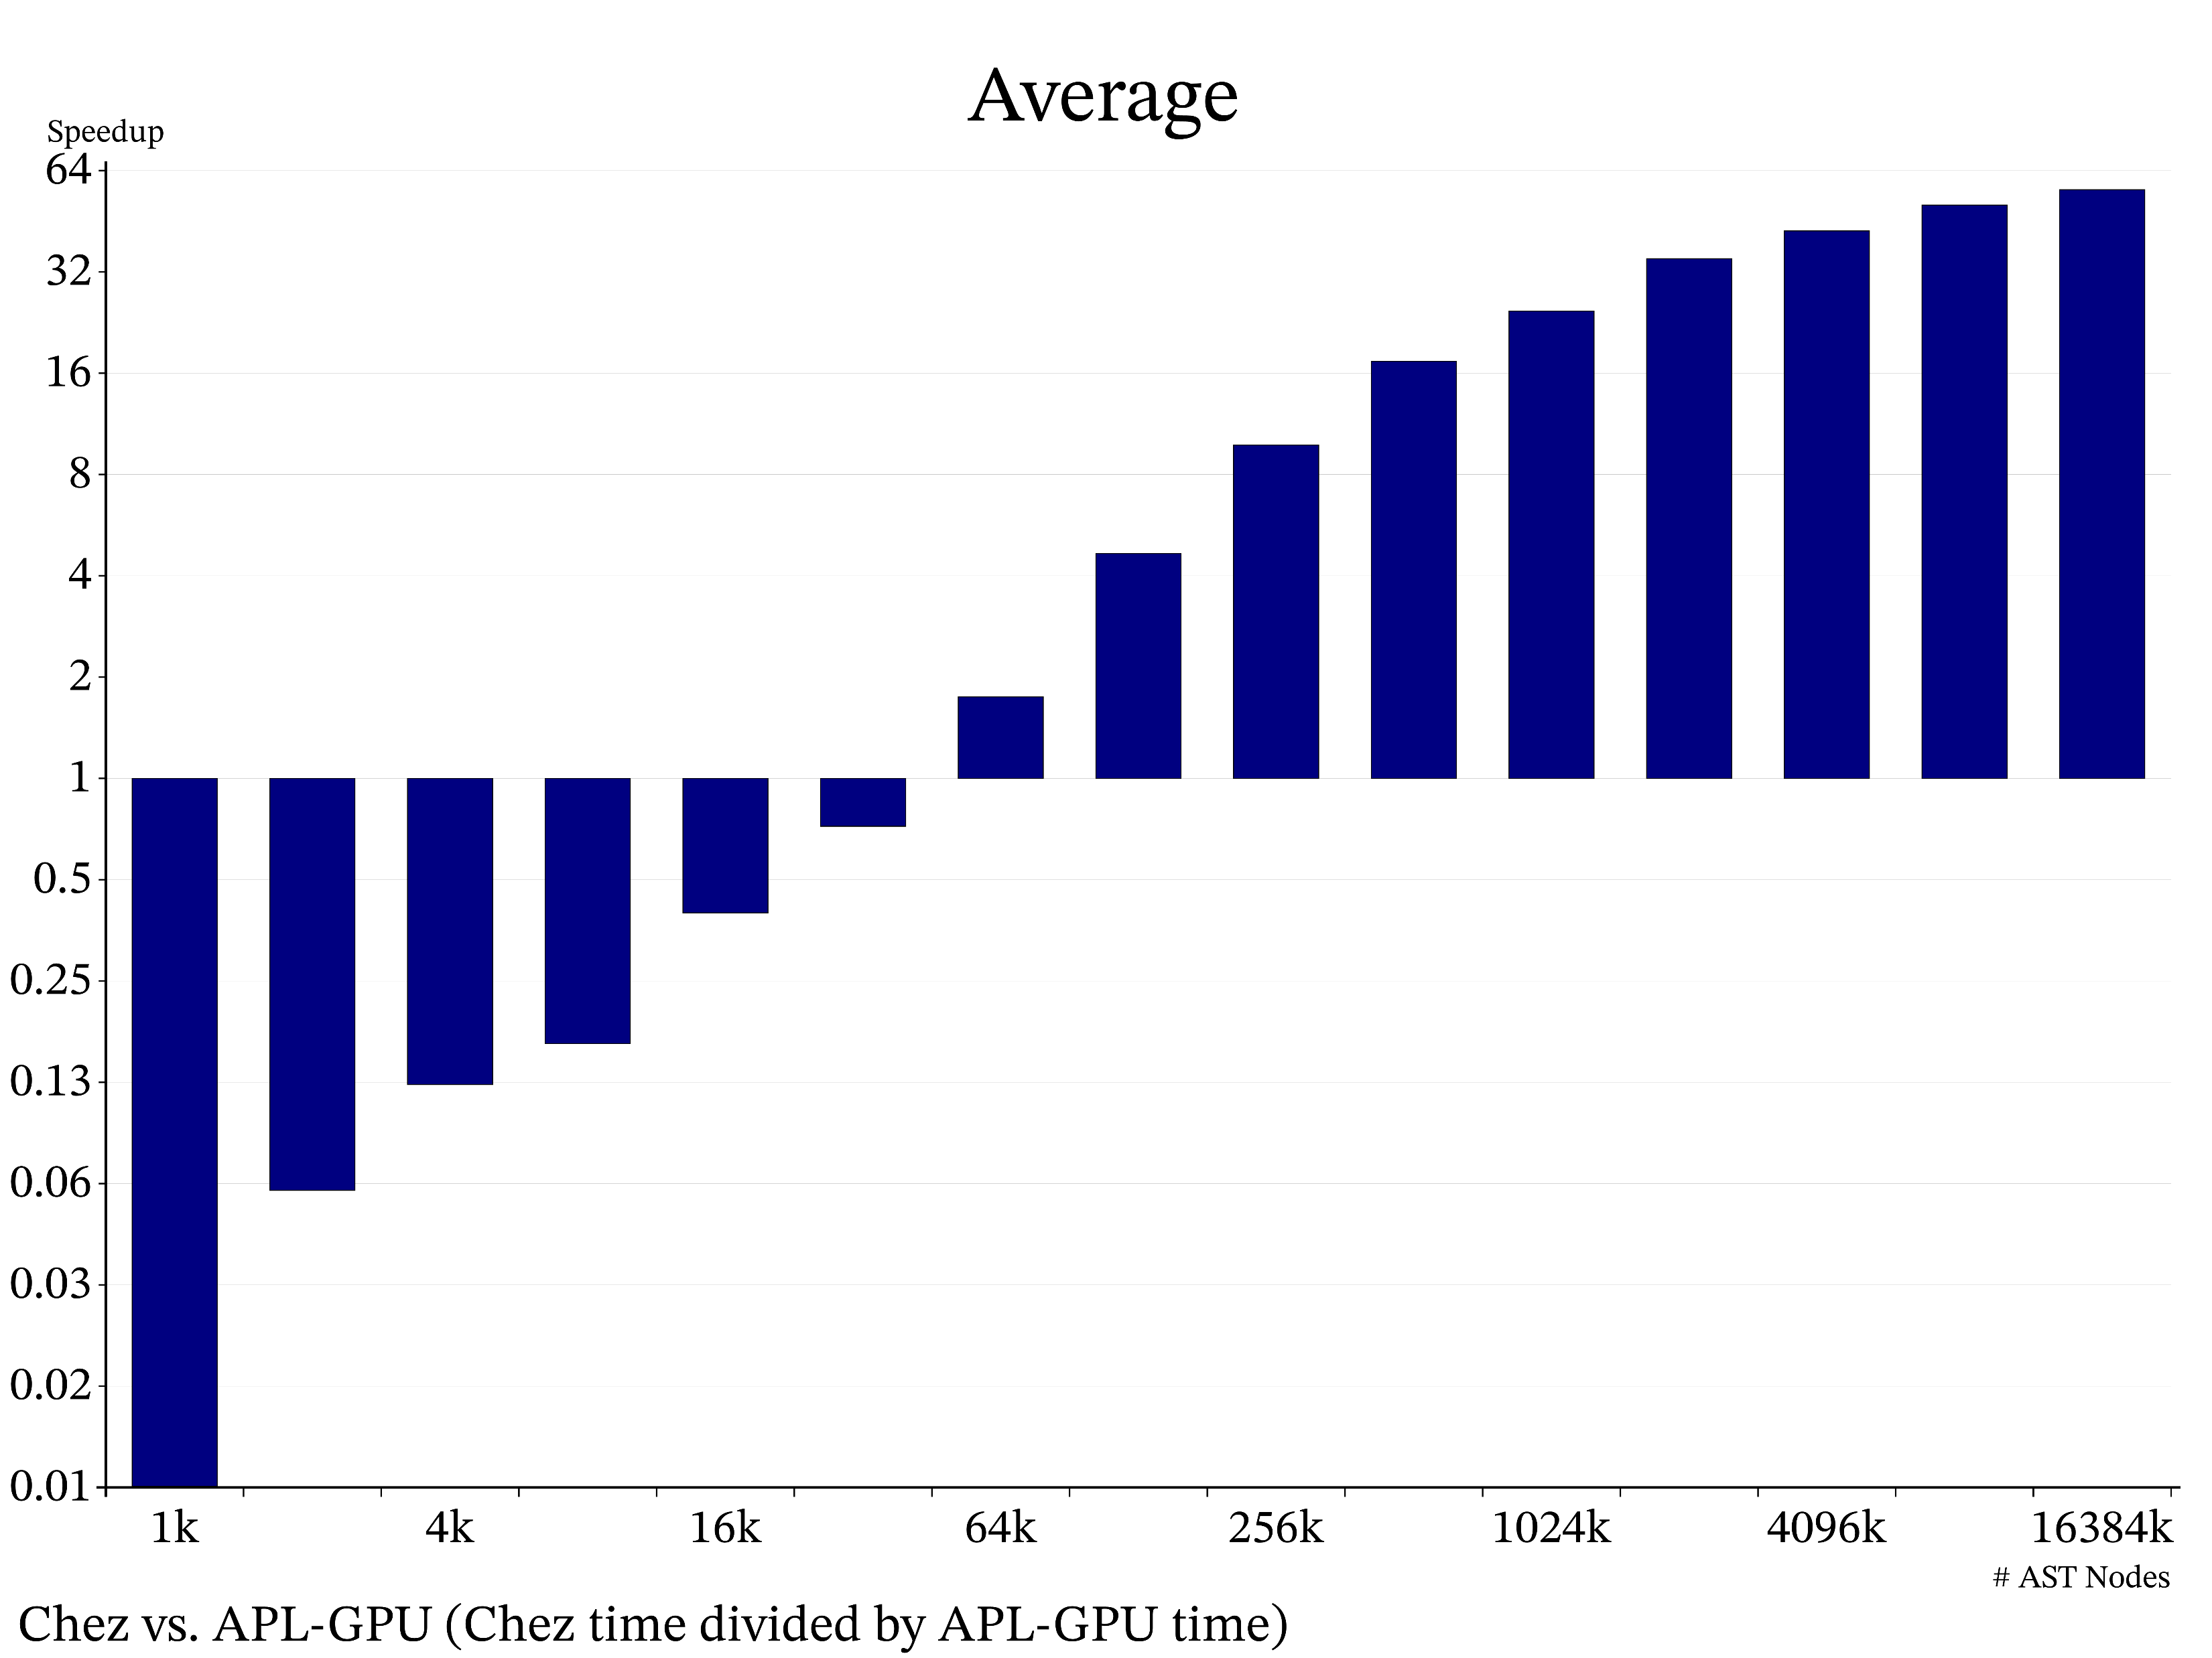

Slide 40
Memory Usage

Slide 41
Feeling is Believing

Slide 42
Positive Cascading Effects

Slide 43
Conclusion
Start with APL

Slide 44
Thank You.
Aaron Hsu – arcfide@sacrideo.us
A data parallel compiler hosted on the GPU
http://www.dyalog.com

Slide 45
i←(⍸(~t∊3 4)∧t[p]=3),{⍵⌿⍨2|⍳≢⍵}⍸t[p]=4 ⋄ p t k n r⌿⍨←⊂m←2@i⊢1⍴⍨≢p
p r i I⍨←⊂j←(+⍀m)-1 ⋄ n←j I@(0≤⊢)n ⋄ p[i]←j←i-1
k[j]←-(k[r[j]]=0)∨0@({⊃⌽⍵}⌸p[j])⊢t[j]=1 ⋄ t[j]←2
(define i
(catenate
(where
(and
(not (members-of t `(3 4)))
(pequal? 3 (indexing t p))))
((lambda (w)
(replicate
(modulo
(index-gen (tally w))
2)
w))
(where (pequal? 4 (indexing t p))))))
(define m ((at 2 i) (reshape (tally p) 1)))
(define-values (p t k n r)
(let ([m^ (enclose m)])
(apply values
(map (lambda (x) (replicate m^ x))
p t k n r))))
(define j (pminus (scan-first + m) 1)
(define-values (p r i)
(let ([j^ (enclose j)])
(apply values
(map (lambda (x) (indexing j^ x)) p r i))))
(define n
((at indexing (lambda (x)
(pless-equal? 0 x)))
j n))
(define j (pminus i 1))
(array-set! p i j)
(array-set! k j
(negate
(or
(pequal? 0
(indexing k
(indexing r j)))
((at 0
((key (lambda (x)
(disclose (reverse x))))
(indexing p j)))
(pequal 1 (indexing t j))))))
(array-set! t j 2)

